Slide 1

Prototype Design of User Interface
THEMIS
EE308 - Assignment 5：
Group 1: THEMIS
Speaker: Zhou Wenxuan

Slide 2
Content
Part 1: Introduction
Part 2: Designers
Part 3: Developing Tools
Part 4: Design Details

Slide 3
Introduction
Part 1

Slide 4
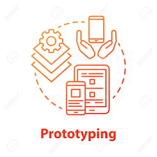
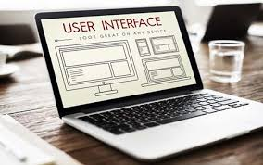
Introduction
Prototype:
A rapid software development to validate requirements. It can help to communicate, and improve the quality.
UI:
User Interface. The bridge between user and product. A good UI can improve user’s experience and product’s usability.

Slide 5
Designers
Part 2

Slide 6
Designers
 | English Name (Pinyin) | Chinese Name （中文名） | Sutdent ID
Designer 1 | Zhaoqing Lin | 林兆青 | 832101217
Designer 2 | Xinyun Li | 李欣芸 | 832101211
Designer 3 | Yuyang Hua | 华雨杨 | 832101207

Slide 7
Developing Tools
Part 3

Slide 8

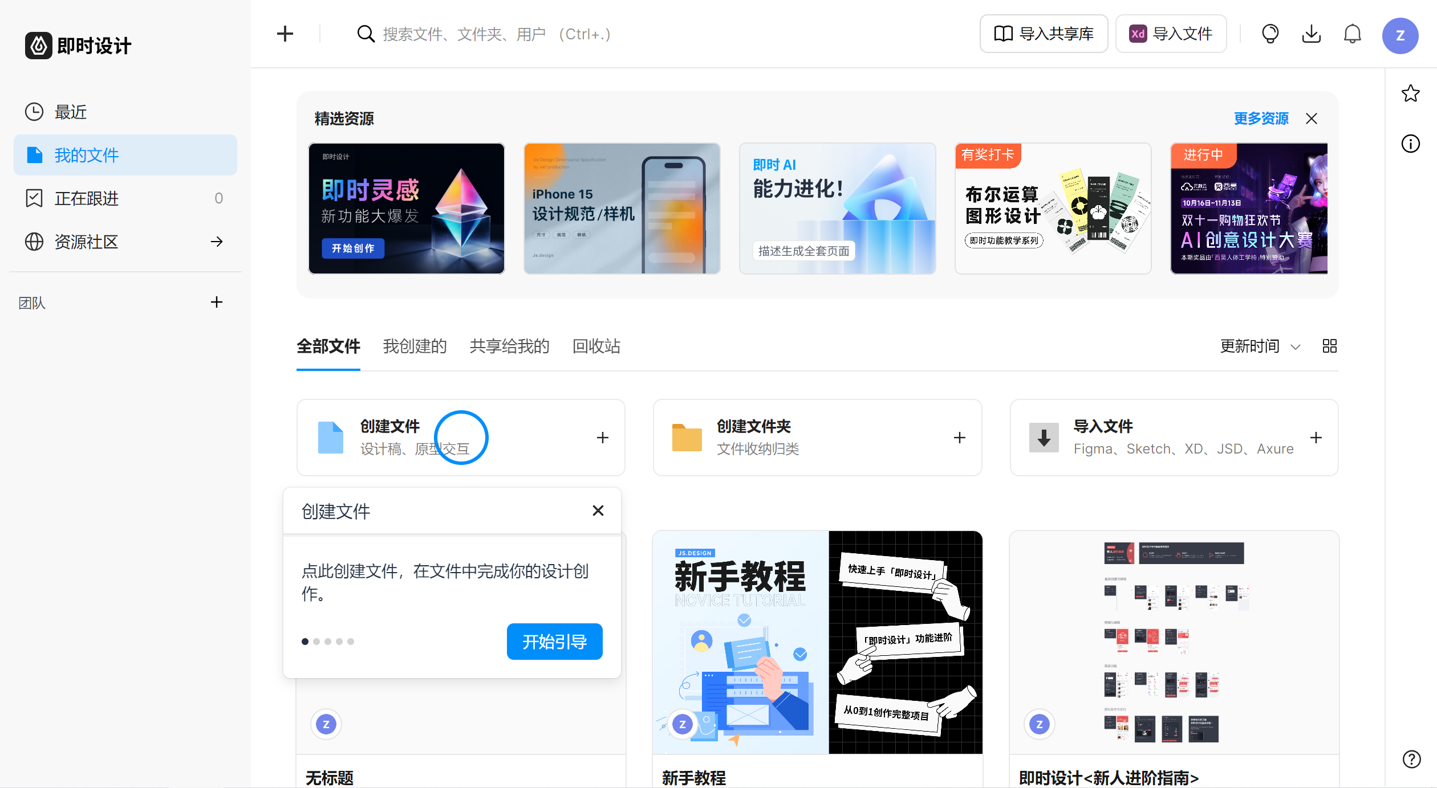
Tool: JsDesign
JsDesign is a designing platform that supports online collaboration.
Designers tried different ideas with its useful functions.

Slide 9
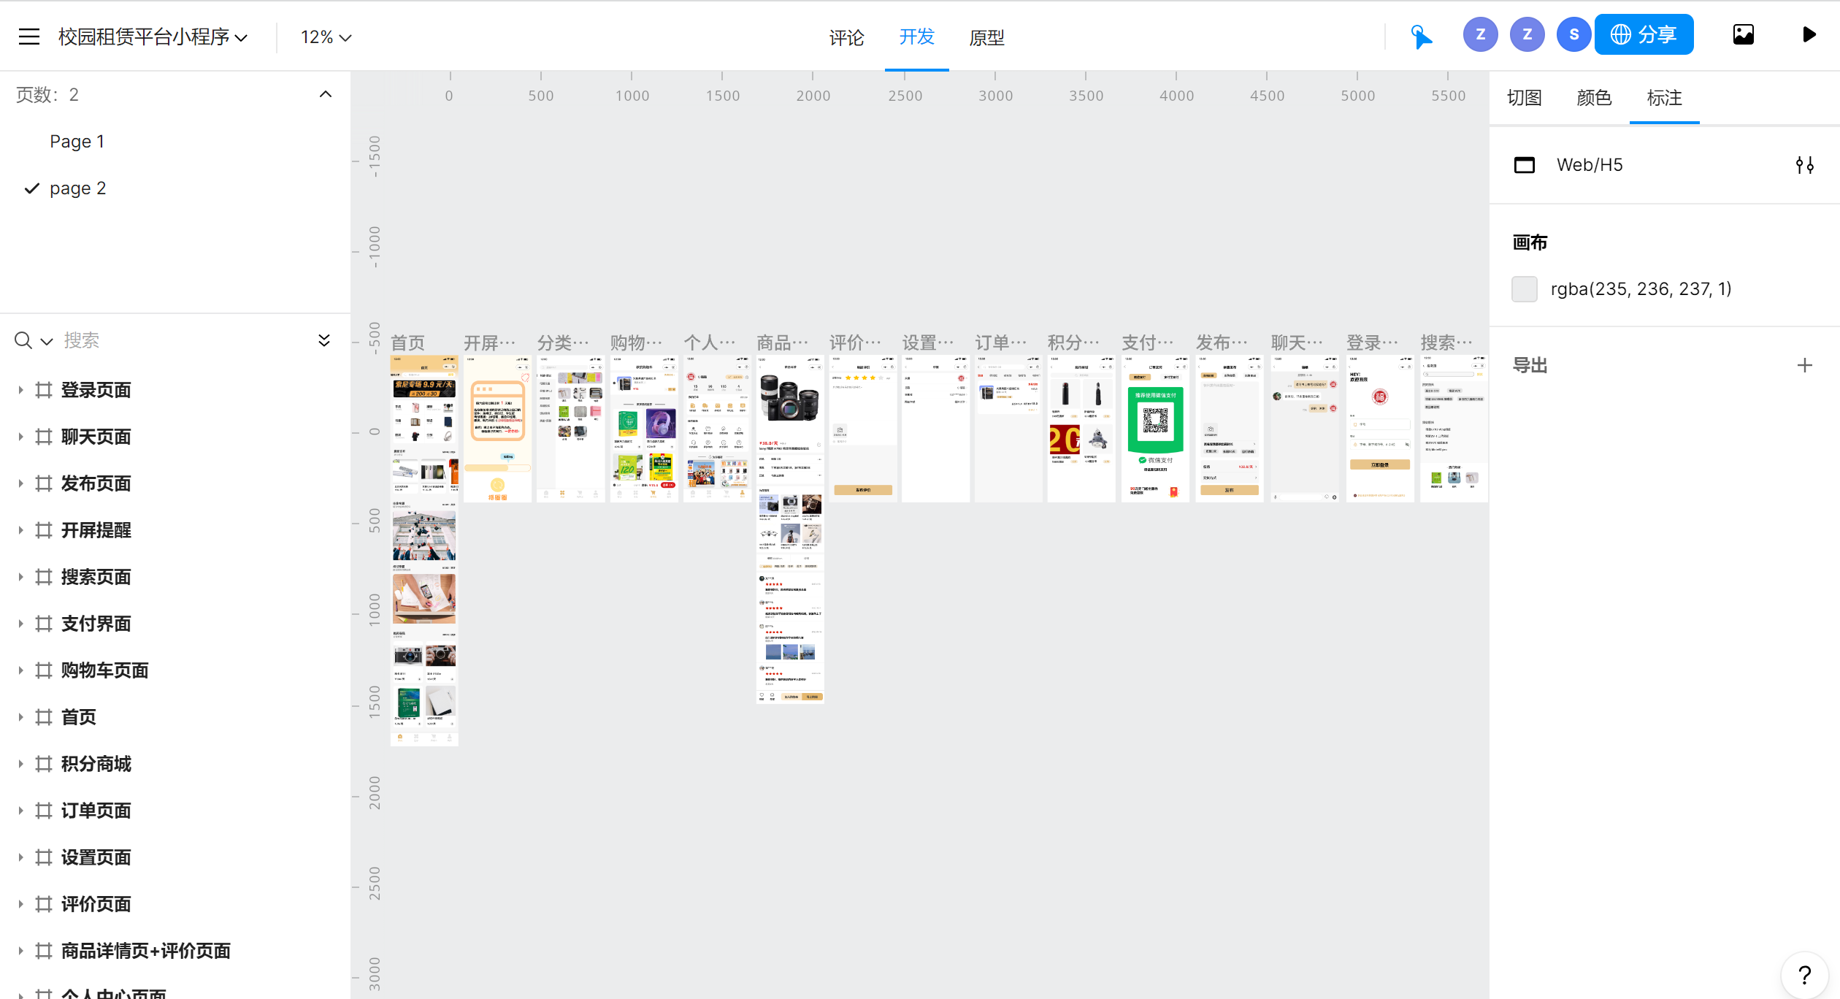
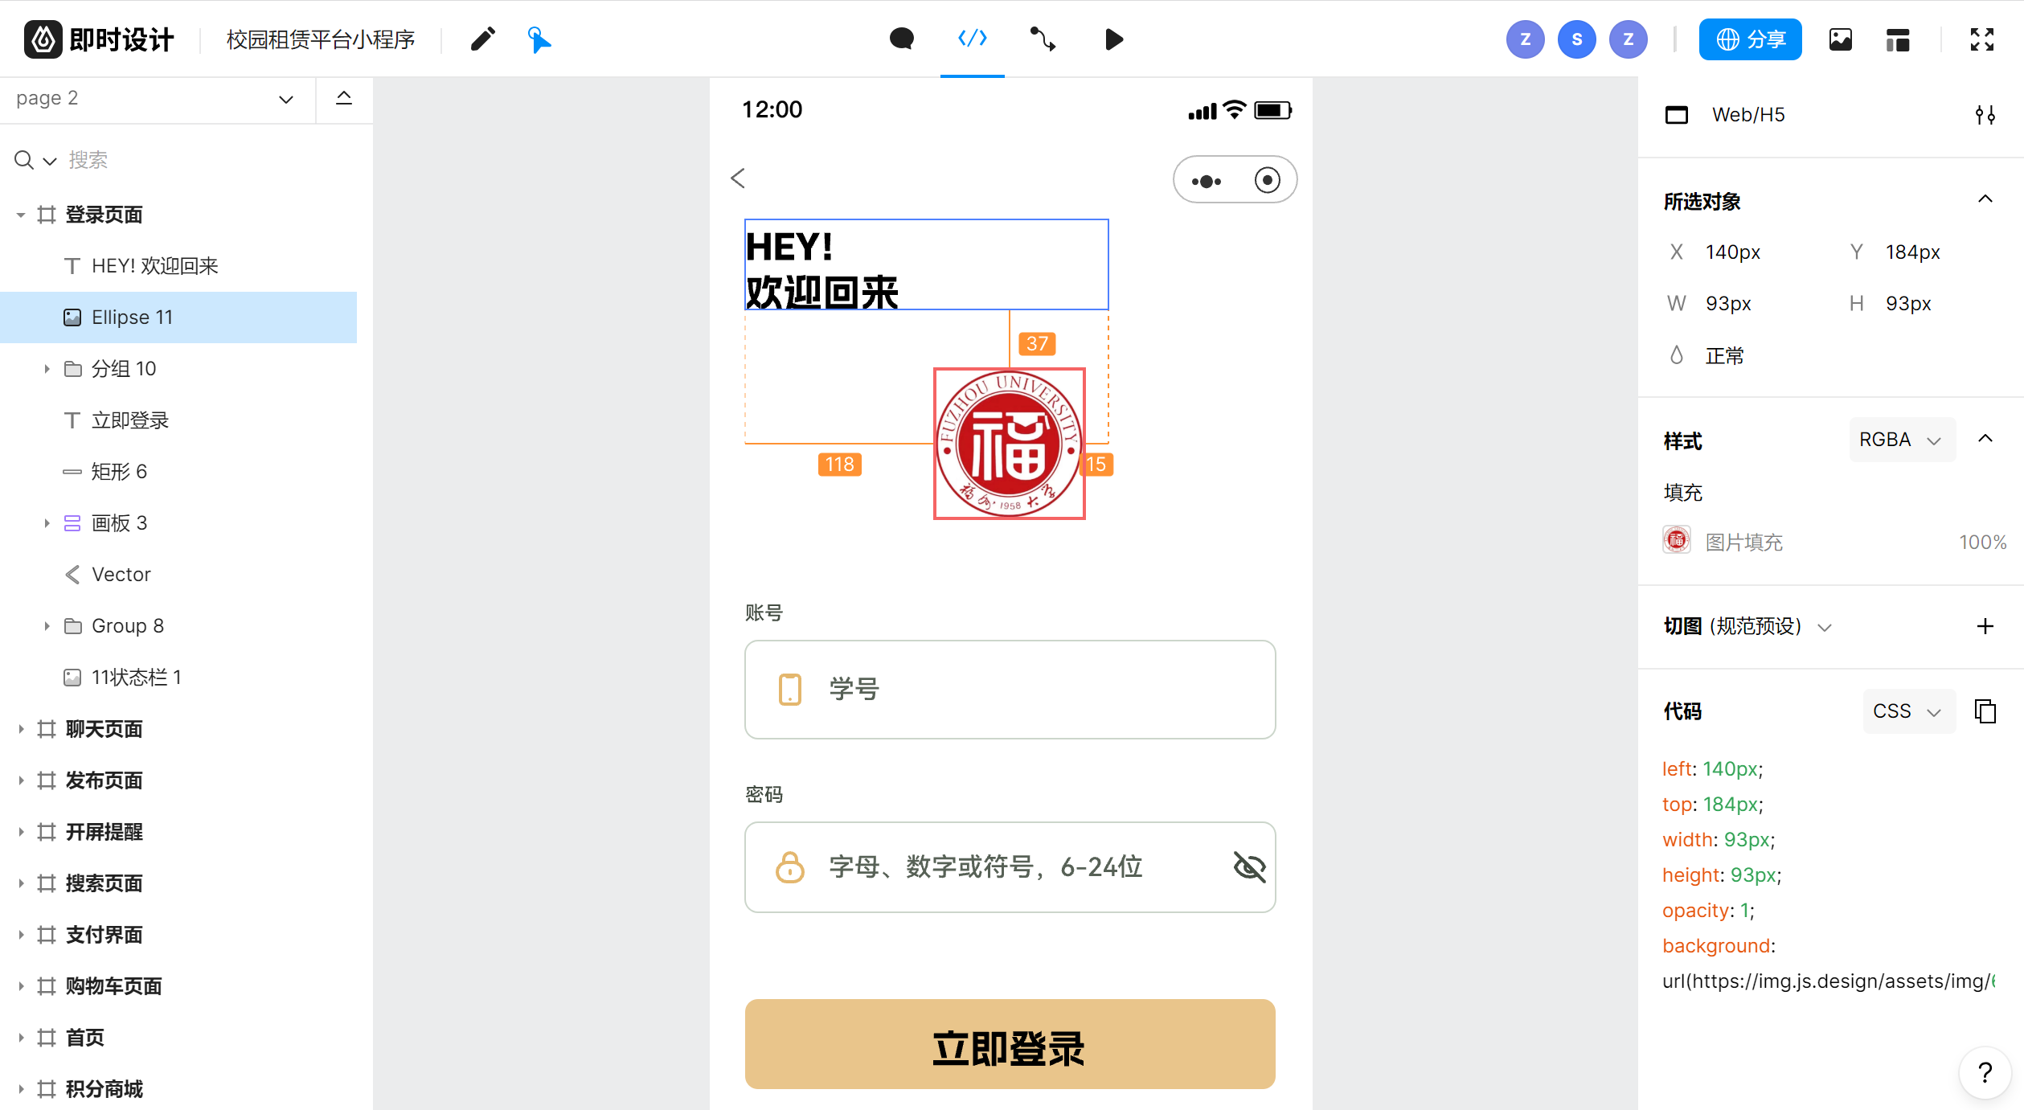
Tool: JsDesign
Developing
Prototype preview

Slide 10
Design Details
Part 4

Slide 11
Considering previous products Basing on our own requirements Making sense of user’s experience
Main ideas:

Slide 12
User Experience Team concept Functionality Responsiveness
Key Points:

Slide 13
Developing Process
Discuss the requirements, determine the division of labour.
1
Choose the tool, learn and working on designing.
3
Evaluate and improve the achievement.
4
Summarize and report.
5
Market research, analyze previous products.
2
*learning
*design direction
*interaction,
user experience
Designing Process

Slide 14






Main Parts
Home Page
All Items
Login
Purchasing
Personal

Slide 15
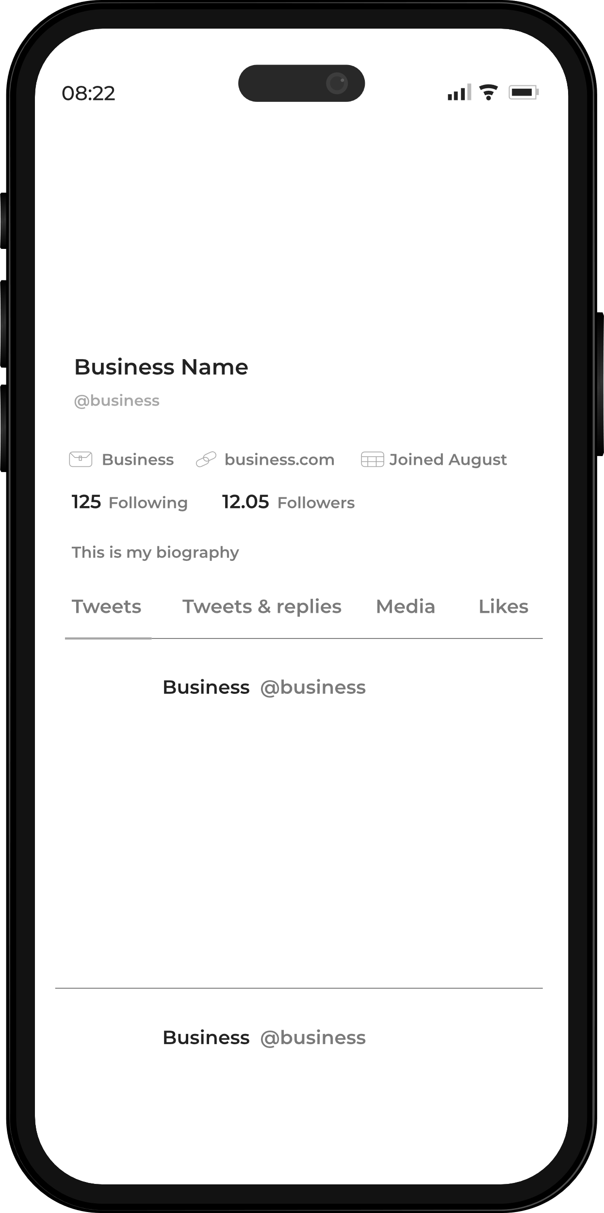
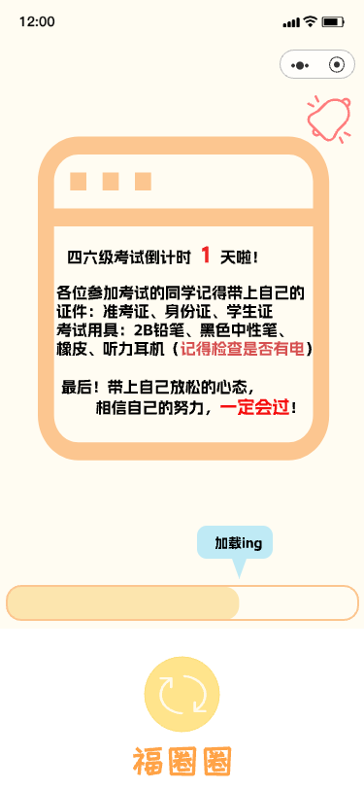
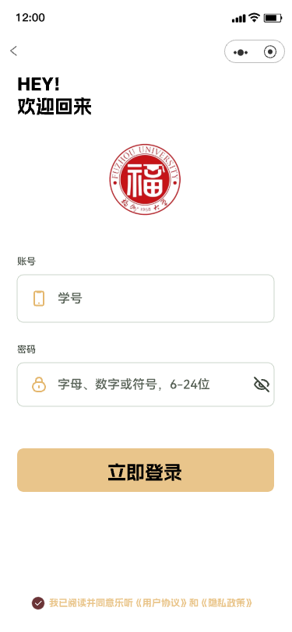
Begin Page
Loading page
The loading page will display important time nodes to indicate
Login page
Login with student number and password

Slide 16
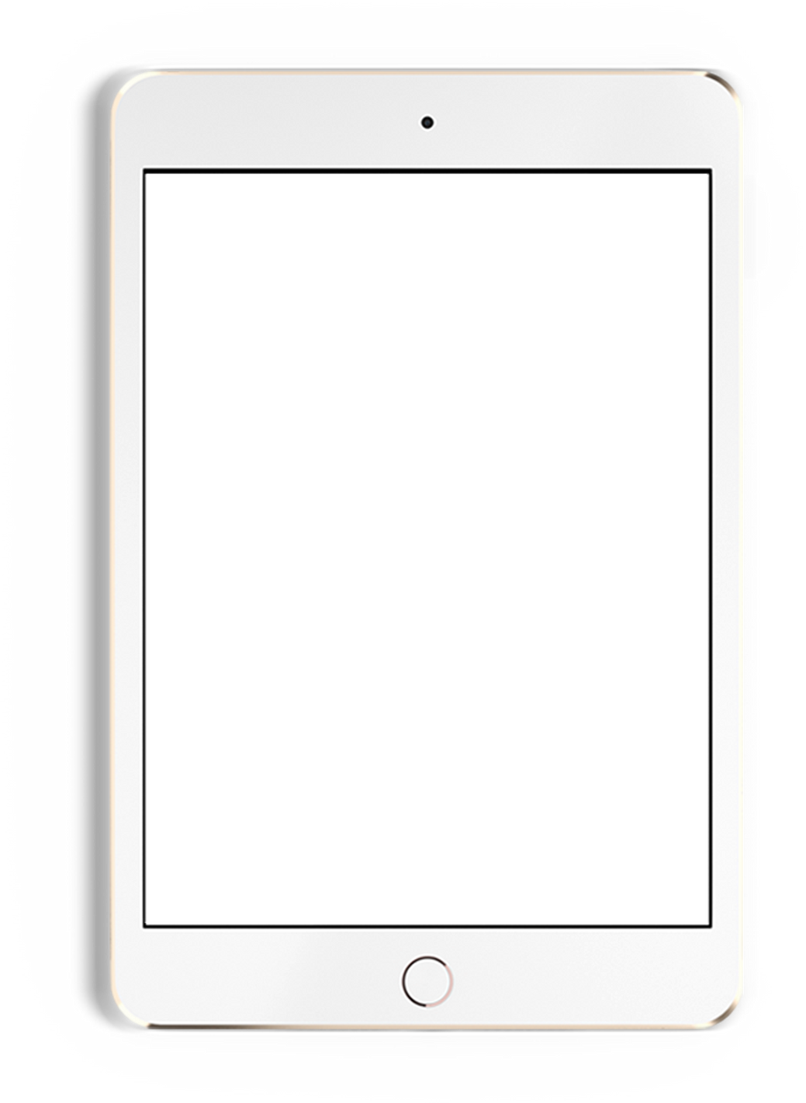
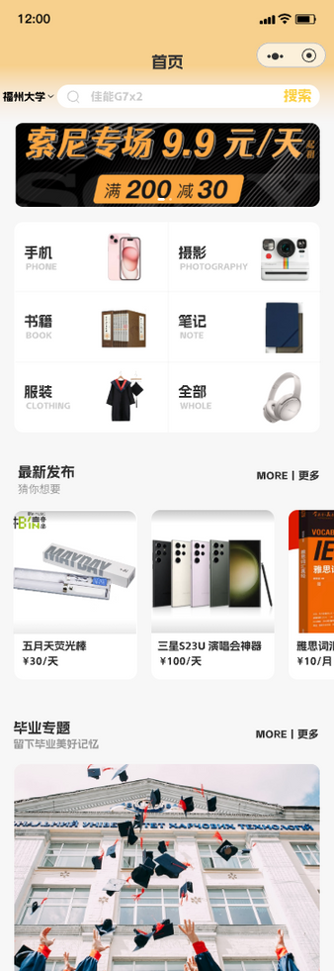
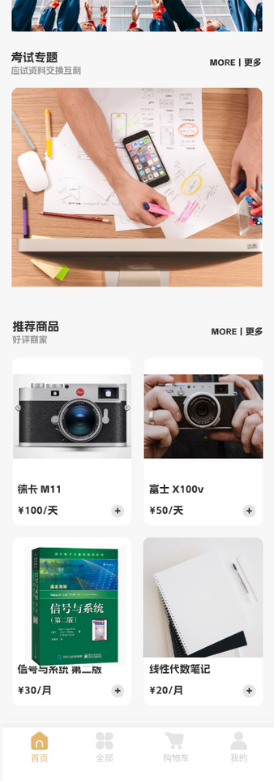
Home Page
Special topics
Search bar
Offering specialized topics, such as graduation topics, are products published by graduates
Commodity classification
Latest release
Navigation bar

Slide 17
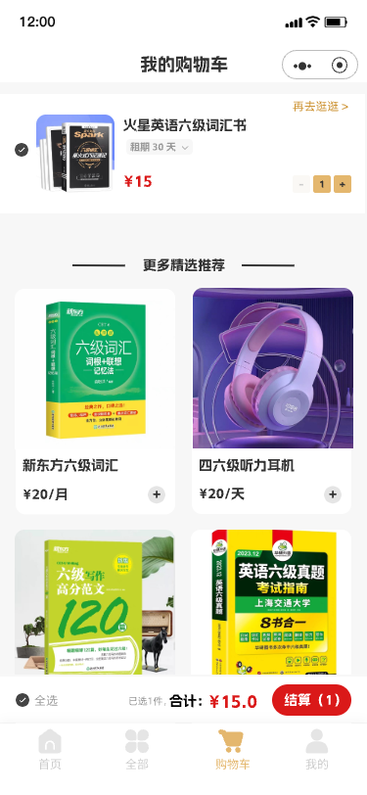
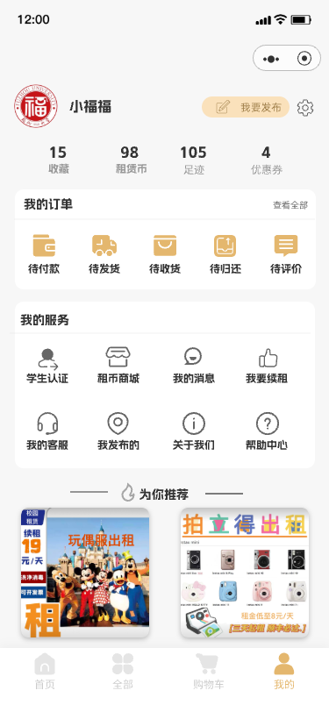
Centers
Personal center
There are more additional features in the personal Center, such as student accreditation and a currency mall
Shopping cart

Slide 18
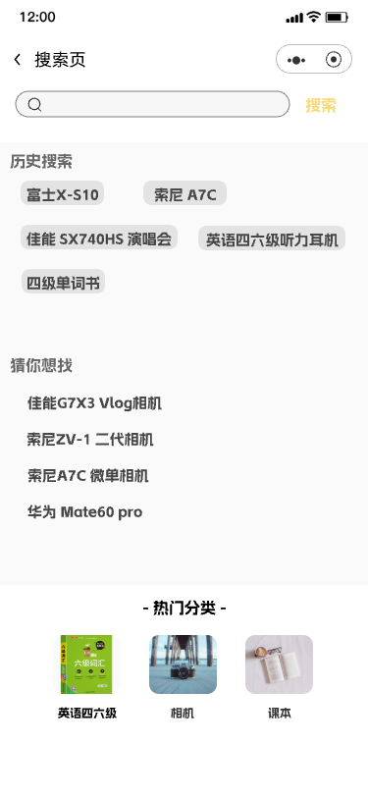
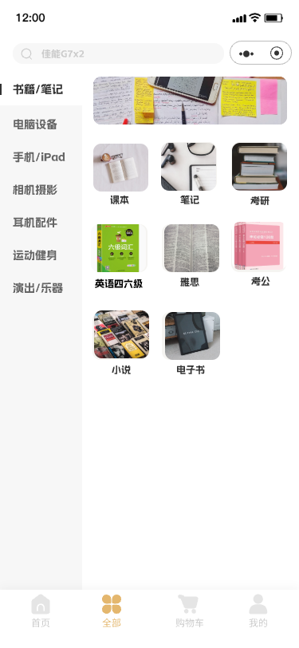
Searching
Search bar
Popular categories

Slide 19
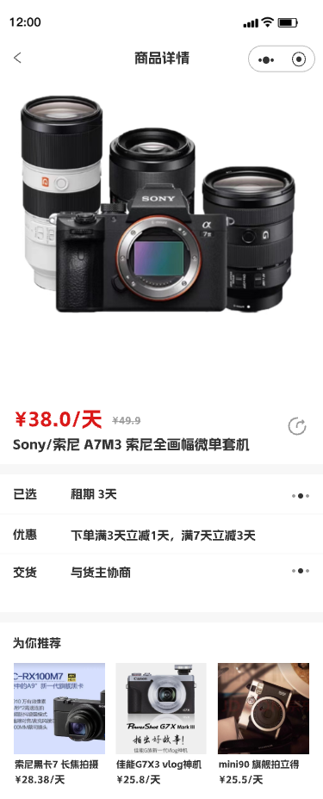
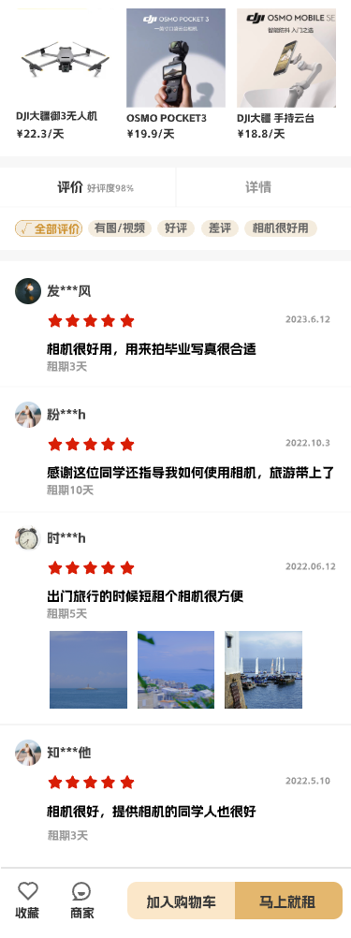

Commodity
In this interface, you can see the details of the commodity and other users' reviews
Commodity details
Comments reviewing

Slide 20
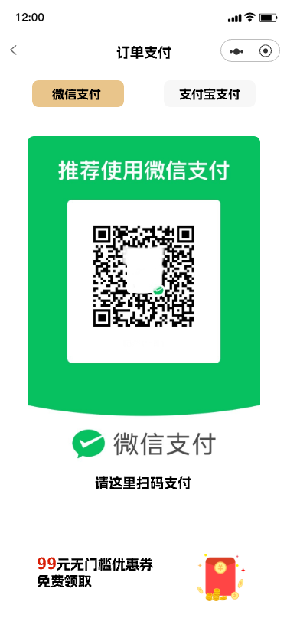
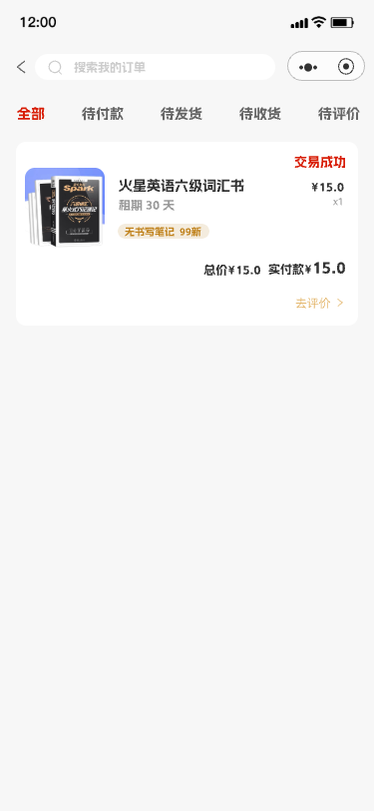
Purchasing
Payment page
Various payment methods, Wechat and Alipay are available
Order page
Here you can select the order information of different states

Slide 21
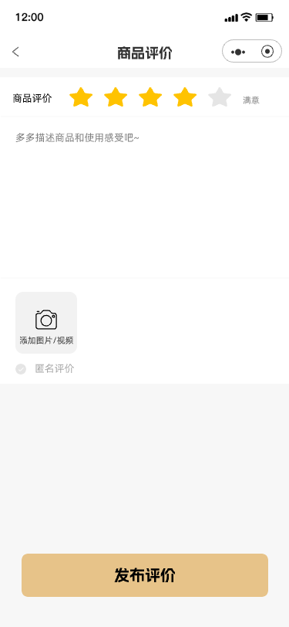
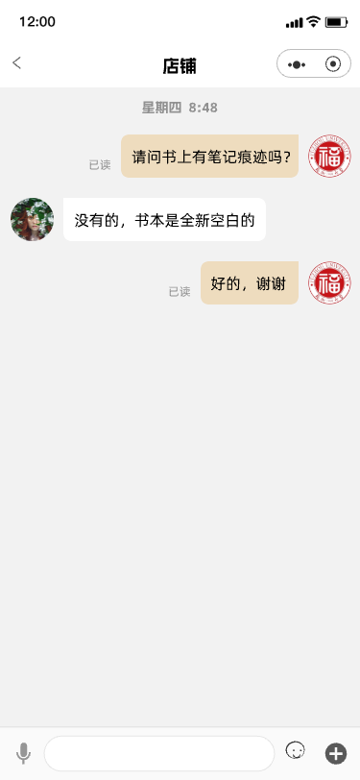
Chatting
After-sales evaluation page
After the purchase can be evaluated, for other users reference
Pre-sales communication page
Communicate before purchase to have a better experience

Slide 22
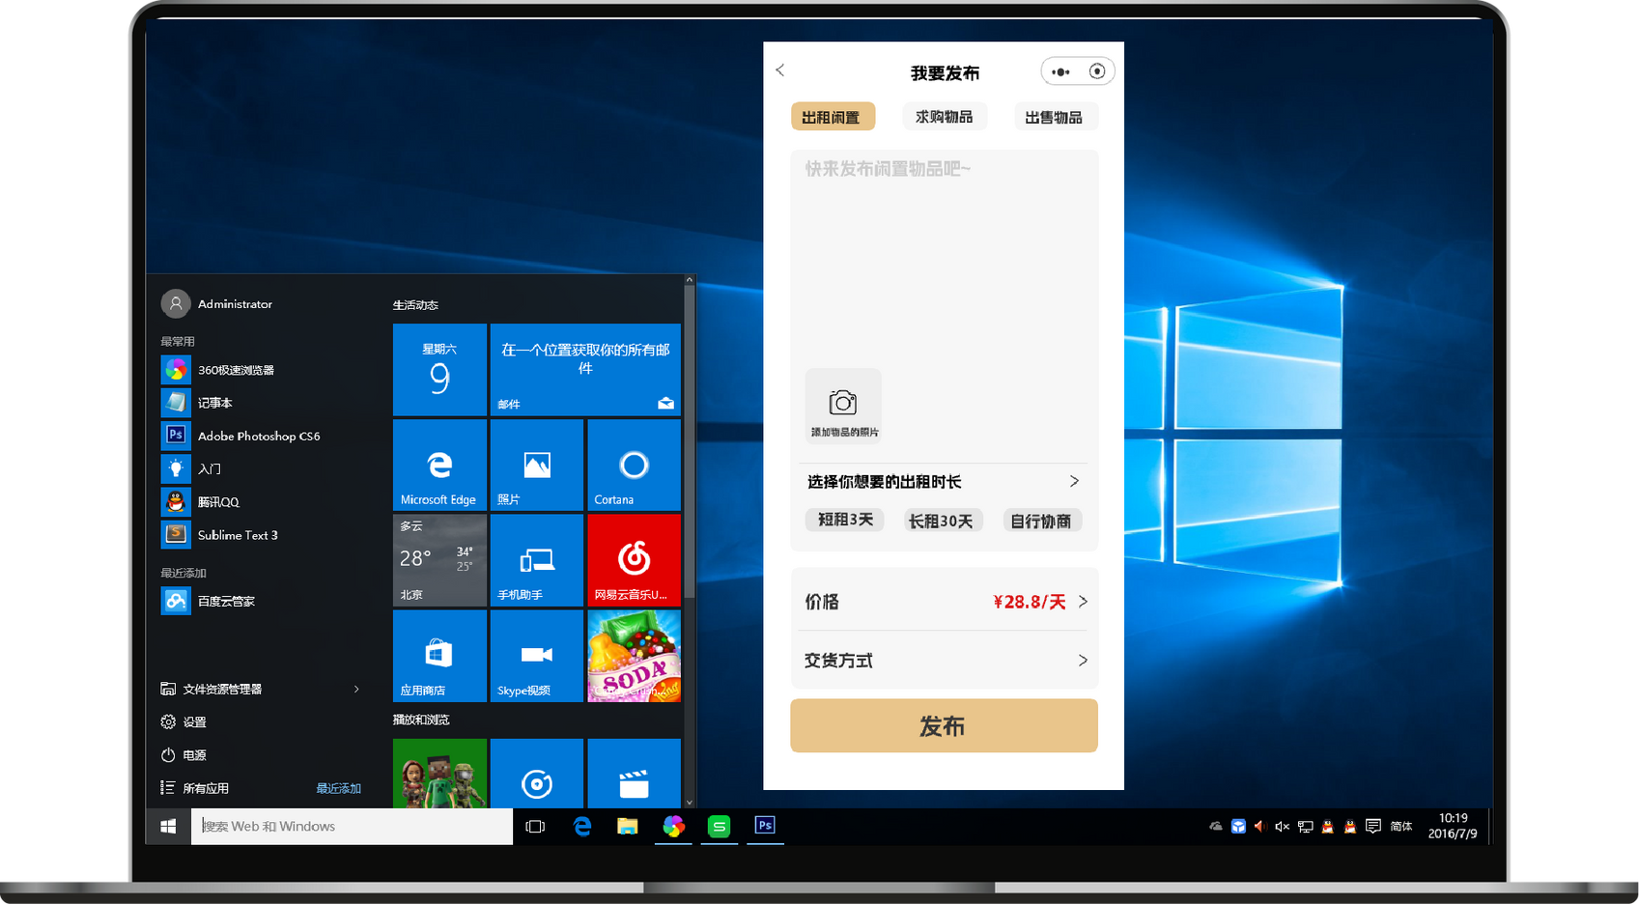
Publishing
Rental term and price setting
Select type
Commodity information

Slide 23
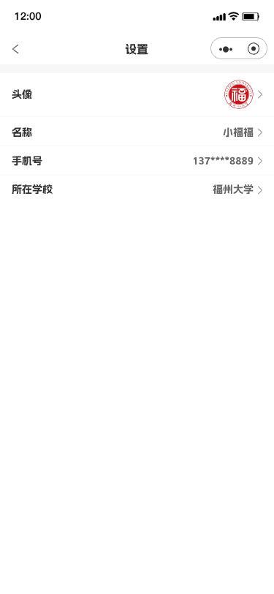
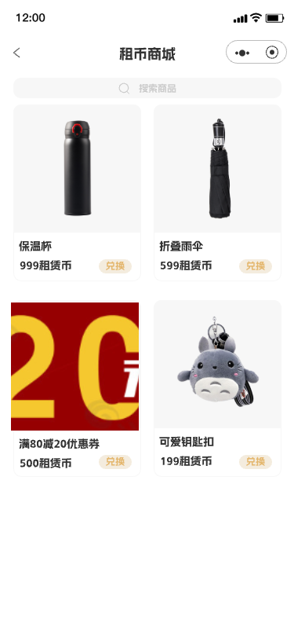
Personal Page
Personal information modification
Leasehold merchant excess
After each lease, you can get lease coins, which can be exchanged at the lease mall

Slide 24
Difficulties
Problems
Solutions
Screen size limitations
Complexity of interaction design
Data display and processing
Integration with back-end interfaces
Mini-program specifications and limitations
Collaboration between design and development
Using responsive design principles, testing
Breaking them down into smaller, adding cues
Using visualization, optimizing loading processes
Explaining demands clearly, more communication
Concerning them all the time, update
Regular meetings, designing handoffs, feedback

Slide 25
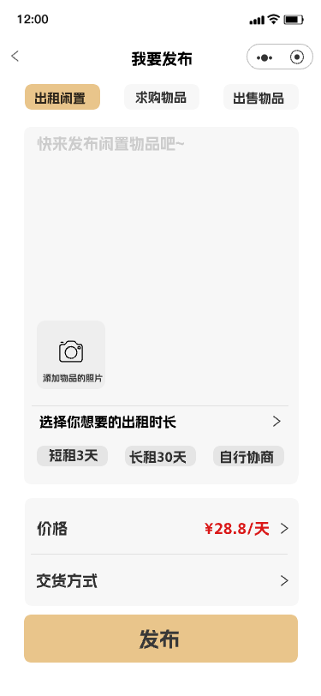
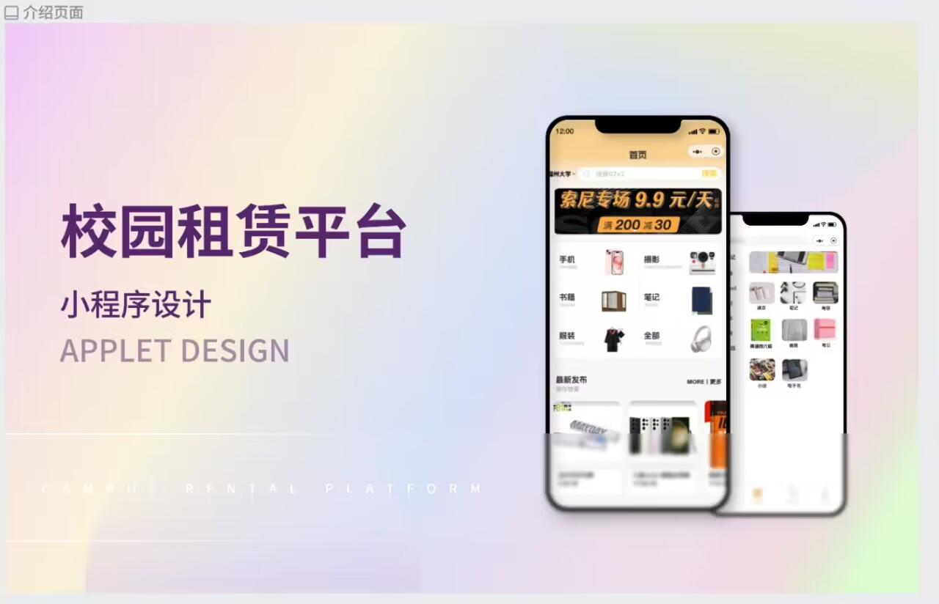
Summary
After days of hard work, we successfully created a user-friendly prototype. We learnt more about what users really need, and know more about how to design. Besides, our achievement is very useful for next step.

Slide 26


Thanks!
Group: THEMIS
EE308FZ, MIEC
THEMIS

